Slide 1
Structure-Dynamic Data Structures
Ben Pierce (bgp12)
EECS 233

Slide 2
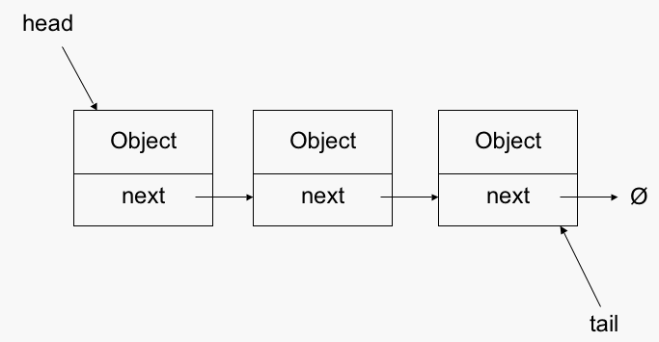
Linked Lists-Structure

Slide 3
Linked Lists- Use Case
Desirable | Undesirable
Need to make frequent additions | Sorting
Need to make frequent removals | Accessing a specific element
Unknown number of items | Known number of items
Smaller data sets | Quick iteration over the list
“One dimensional” data | Larger data sets

Slide 4
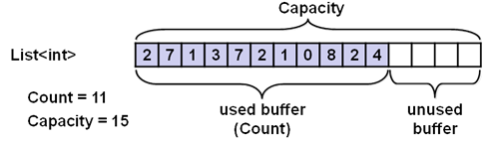
ArrayList- Structure

Slide 5
ArrayList- Use Case
Desirable | Undesirable
Indexes/Access to a specific element | Small data sets
Have/need control over memory | Unknown number of elements
Need easy iteration over the elements | Need to remove elements
Need elements sorted | Need to add elements in the middle/end

Slide 6
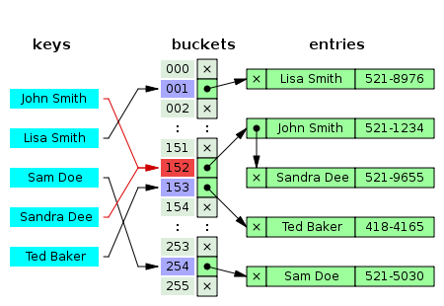
HashTable- Structure

Slide 7
HashTable- Use Case
Desirable | Undesirable
Large set of data | Small data sets
Need quick access to selected data points | Want to sort
Hashable input | Compare to other hash tables quickly
 | Data with many collisions when hashed

Slide 8
Combining the Concepts
Bottom Line: All of these data structures have different use cases.
Question: Which data structure should be used for an implementation.
Proper Answer: Try multiple out, and experimentally determine which is the most efficient for your specific use case.
Issue: This takes a lot of time.

Slide 9

Issue: Time is Money, Friend

Slide 10
Solution
One data structure that can dynamically shift between separate designs

Slide 11
Advantages | Disadvantages
Good for simple prototyping | Slower then each individual data structure (Overhead)
Straightforward in design | Can utilize wrong data structure
Quick to implement into a project | Less programmer control
Fits an object-oriented, abstract design | More complex then individual structures
Extensible/flexible; based on generics | Depends on implementations of Comparable, hash functions

Slide 12
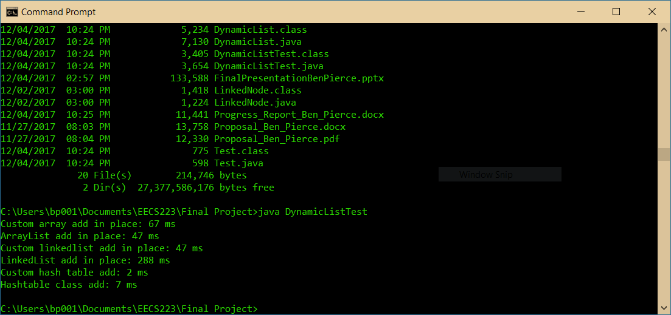
So far…

